Slide 1
AI, Machine Learning and Data Science A Quick Stroll Through Time
Balaji Padmanabhan
Professor, Information Systems & Decision Sciences
Director, Center for Analytics & Creativity
Muma College of Business, USF
bp@usf.edu

Slide 2
Basic Concepts in AI & Algorithms
Motivations for AI
Importance of good representation (for problem solving and algorithms)
Complexity
Link to Machine Learning

Slide 3
Some background
Artificial Intelligence and Problem Solving (70s, 80s and early 90s)
Problems:
Moving blocks around a room
Cooking recipes
Playing chess
Finding paths
Generalizing from examples
Also “concept learning” in a spawned field called “Machine Learning”, which in part spawned “Data Mining”

Slide 5
Motivation 1 for AI
Building machines that demonstrate human intelligence.
Turing Test, named after Alan Turing
Eliza, was one of the first rule-based programs that could “talk” like a human.
Example rule in such a script:
My family-member is Y → (Who else in your family is Y?)
Methodology: Natural language processing, formal logic, rule-based expert systems etc.

Slide 6
Demonstrating Human Intelligence - 1
MYCIN Example from http://slideplayer.com/slide/3291839/

Slide 7
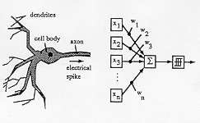
Demonstrating Human Intelligence - 2

Slide 8
One Theme/Debate in Artificial Intelligence
Symbolic vs Connectionist Approaches
Which is better?
Symbolic
Knowledge in the form of rules, or expressions based on symbols and formal logic
Connectionist
Neural architectures and optimizing weights

Slide 9
Motivation 2: Combinatorial optimization
Searching through a large discrete “search space” of solutions to find the best solution to a problem
Some search algorithms can be guaranteed to find the optimal solution “in reasonable time”
E.g. Djikstra’s algorithm to find the shortest path between two vertices in a graph
O((m+n).logn), where n is the number of nodes in the graph and m the number of edges.

Slide 10
Motivation 2: Combinatorial optimization
Some search algorithms cannot be guaranteed to find the “optimal” solution “in reasonable time”
Traveling Salesman Problem (TSP) is one where the goal is to traverse a list of cities in the shortest time/distance such that all cities are visited
Worst case time is exponential in the number of cities.
What to do in such cases?
Design “special case” solutions that may be guaranteed to find the optimal solution efficiently, For example:
R.E. Burkard, V.G. Deineko, R. van Dal, J.A.A. van der Veen and G.J. Woeginger, Well-solvable special cases of the traveling salesman problem: a survey, SIAM Rev. 40 (1998) (3), pp. 496–546.

Slide 11
Motivation 2: Combinatorial optimization
What to do in such cases?
Develop “heuristics” which are techniques that find “good” solutions but no guarantees on finding the “best”.
Heuristics related to satisficing, Herb Simon’s bases and links into bounded rationality
The field of AI has come up with several “heuristic search” algorithms, many of which are based on versions of greedy hill climbing.

Slide 12
Hill Climbing Heuristic in Combinatorial Optimization
Many combinatorial problems have the following characteristics:
You have a function, f, that tells you exactly how good each point in the search space is.
But the search space is very large and simply cannot be exhaustively enumerated
There is nothing about the problem that will permit you to cleverly find the optimal point
Hill climbing will select the neighbor of the current point that is “most promising” and stop when it reaches a peak.
Foiled by multiple peaks (local minima versus global minima), strange terrains

Slide 13
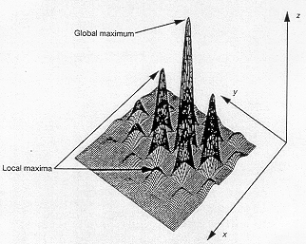
Hard Terrains (Dhar and Stein)

Slide 14
Hill Climbing
x = current solution, goodness f(X)
Repeat until (stopping condition) {
Moves = Neighbors(X)
If ( f(p) < f(x) ∀ p ∈ Moves ) then
Stop
Else
x = best such p ∈ Moves
}

Slide 15
Randomized Hill Climbing
x = current solution, goodness f(X)
Repeat until (stopping condition) {
Moves = Neighbors(X)
If ( f(p) < f(x) ∀ p ∈ Moves ) then
Stop
Else
x = random p ∈ Moves where f(p) > f(x)
}

Slide 16
Simulated Annealing
x = current solution, goodness f(X)
Repeat until (stopping condition) {
Moves = Neighbors(X)
k = random move from Moves
If f(k) > f(x) then
accept k as current solution (x)
Else
with some probability accept k still.
}

Slide 17
Simulated Annealing: Setting the probability of accepting bad moves
When f(k) < f(x) accept the (bad) move with probability:
exp( -(fitness sacrifice) / T_{i} )
T_{i} is the temperature on iteration “i” and the idea is to have this “temperature” cool over time/iterations.
Why?

Slide 18
AI Summary Part 1
Focused on algorithms to solve problems, search complicated search spaces (in pursuit of problem solving) and demonstrate intelligence
Built lots of general purpose heuristic search algorithms
Conceptually fought knowledge representation battles
What is knowledge and how should it be represented?

Slide 20
Basic Concepts in AI & Algorithms
Motivations for AI
Importance of good representation (for problem solving and algorithms)
Complexity
Link to Machine Learning

Slide 21
Representation in Artificial Intelligence
In problem solving, representation always comes first. Good representations are known to facilitate problem solving.
Example Problem 1:
Farmer, Fox, Goose, Grain, Boat problem
Farmer needs to take {fox, goose, grain} to the other side of the river and has a boat that can at most take one other thing/person.
Fox left alone with goose is bad
Grain left alone with goose is also bad.
Fox, grain, goose left alone is also (clearly) bad.
Find all solutions. Assume all are in one side at start.

Slide 22
Graph Formalism
Graph G = <N, E>
N = {n₁, n₂,…,n_{k}} is the set of nodes
E = {<i,j> | i, j ∈ N and there is an edge from i to j}
Alternately,
Graph G = <N, M>
N = {n₁, n₂,…,n_{k}} is the set of nodes
M is an n x n square matrix where M(i,j) = 1 iff there exists an edge from i to j.
Note, both formalisms above represent directed graphs.

Slide 23
F f G g --
F = Farmer
G = Goose
f = fox
g = grain
f g – F G
F f g -- G
f -- F G g
g --F f G
F f G -- g
F G g -- f
G --F f g
F G -- f g
-- F f G g

Slide 24
F f G g --
F = Farmer
G = Goose
f = fox
g = grain
f g – F G
F f g -- G
f -- F G g
g --F f G
F f G -- g
F G g -- f
Solution is now
almost obvious!
We still need an algorithm
that can efficiently use
this representation to find
a path between two nodes
G --F f g
F G -- f g
-- F f G g

Slide 25
Example Problem 2: Traveling between cities
Cities: {S, A, B, C, D, E, F, G}
distance(S, A) = 3
distance(S, D) = 4
distance(D, A) = 5
distance(B, A) = 4
distance(D, E) = 2
distance(B, E) = 5
distance(E, F) = 4
distance(B, C) = 4
distance(F, G) = 3
Find a path between S and G
Find all paths between S and G
Find shortest path between S and G

Slide 26
Representation as a Graph

Slide 27
AI Summary Part 2
Good representation is critical.
Generalizes beyond AI and search algorithms. The representation issue asks how you might abstract unstructured problems into mechanisms that lend themselves to efficient pondering.
Graphs/Trees are common representations for many types of problems in AI
which is why a lot of search algorithms are developed for these formalisms.
Think of “search” as systematic and efficient enumeration of the possible solutions.

Slide 28
Basic Concepts in AI & Algorithms
Motivations for AI
Importance of good representation (for problem solving and algorithms)
Complexity
Link to Machine Learning

Slide 29
Algorithmic Concepts: Time and Space Complexity
The “Big O” notation is used to indicate how long (or how much space) a program will take as a function of the inputs to the program
Bubble sort is O(n²) for instance
Careful analyses of the algorithm can help you identify the number of steps, as a function of an input

Slide 30
NP Completeness
http://www.ics.uci.edu/~eppstein/161/960312.html
As previously discussed, algorithms that solve problems in a polynomial (as a function of inputs) are acceptable as “efficient”.
Often we want to do much better, linear, log etc
NP Completeness implies that a problem is so hard that it cannot be solved efficiently
What to do?
Go with an exhaustive (non-efficient) approach anyway
Use heuristics
Try to redefine the problem, perhaps some additional caveat might make this solveable

Slide 31
Basic Concepts in AI & Algorithms
Motivations for AI
Importance of good representation (for problem solving and algorithms)
Complexity
Link to Machine Learning

Slide 32
Machine Learning
Always had the focus on learning from data.
In a sense, some view it as a subset of AI
If you had data on specific instance, can you draw generalizations from it?
Learning models given specific instances or “inductive learning”
Concept Learning and Neural Networks in the early 80s captured both symbolic and connectionist approaches
90s onward was an explosion in machine learning algorithms (that learn from data)

Slide 33
Links between the two fields
Representation
Problem solving and knowledge discovery both need good representations
In machine learning the representation issue is what form a model learned from data may take
Is it a network, a tree, a regression and so on…

Slide 34
Links between the two fields
Symbolic vs Connectionist Thinking
AI had expert systems with symbolic knowledge.
AI had neural networks with connectionist ideas
Machine learning discovers models that map to symbolic knowledge (decision trees)
Machine learning learns neural networks given data

Slide 35
Links between the two fields
Heuristic Algorithms
AI had many to solve abstract search problems
Machine learning algorithms are based on heuristic search procedures. Many use variants of greedy hill climbing to find their “best” models

Slide 36
AI, Machine Learning and Data Science
First, what is data science?
Connectionist models such as neural networks or deep learning models, when learned from data have strong flavors of both AI and machine learning.
Machine learning models (of any kind), when learned from data and used in “automation” create the kind of human intelligence AI was interested in mimicking in the very first place

Slide 37
Data Science Programming Today
DSP Today = Algorithms + Data + Custom Logic (scripts)
The “custom logic” is how you combine many canned machine learning algorithms with your data to generate insights and solutions specific to your “use case”

Slide 38
Convergence of Machine Learning and AI Concepts today

Slide 39
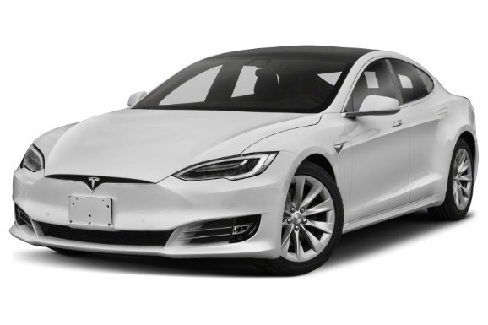

Slide 40
